Slide 1
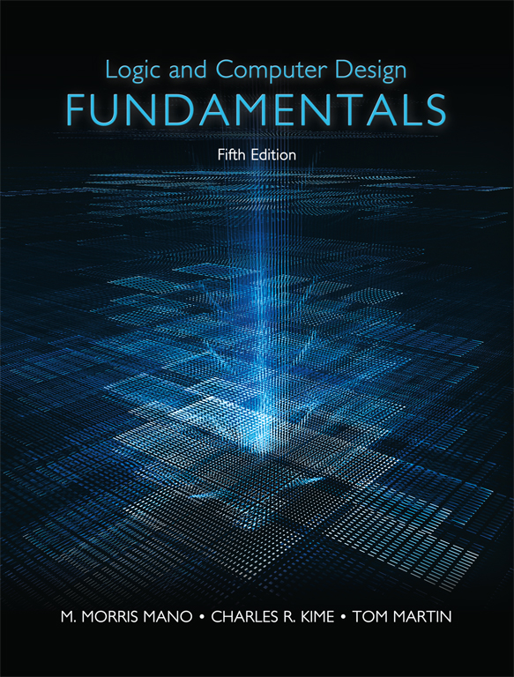
Logic and Computer Design Fundamentals
Fifth Edition
Chapter 1
Digital Systems and Information
Copyright © 2016, 2008, 2004 Pearson Education, Inc. All Rights Reserved
Notes:
If this PowerPoint presentation contains mathematical equations, you may need to check that your computer has the following installed:
1) MathType Plugin
2) Math Player (free versions available)
3) NVDA Reader (free versions available)

Slide 2
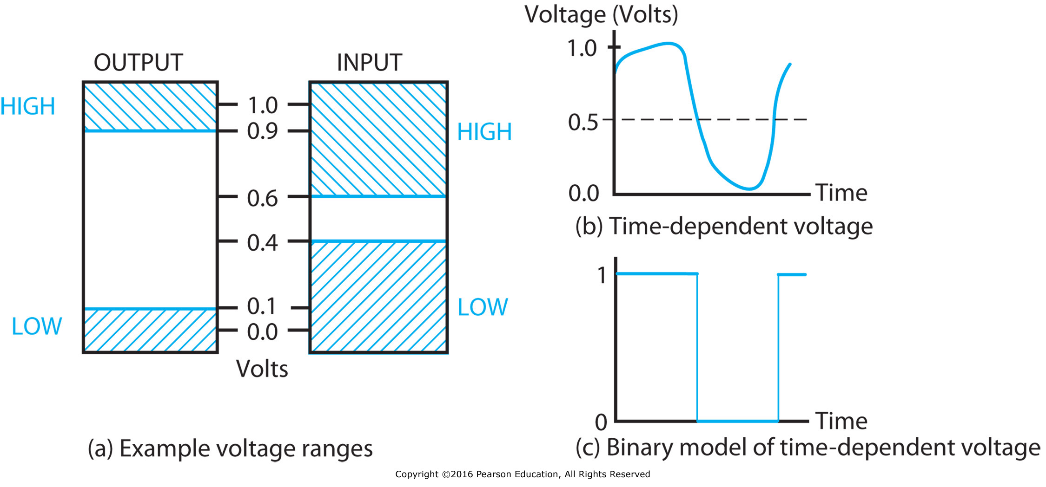
Figure 1-1 Examples of Voltage Ranges and Waveforms for Binary Signals

Slide 3
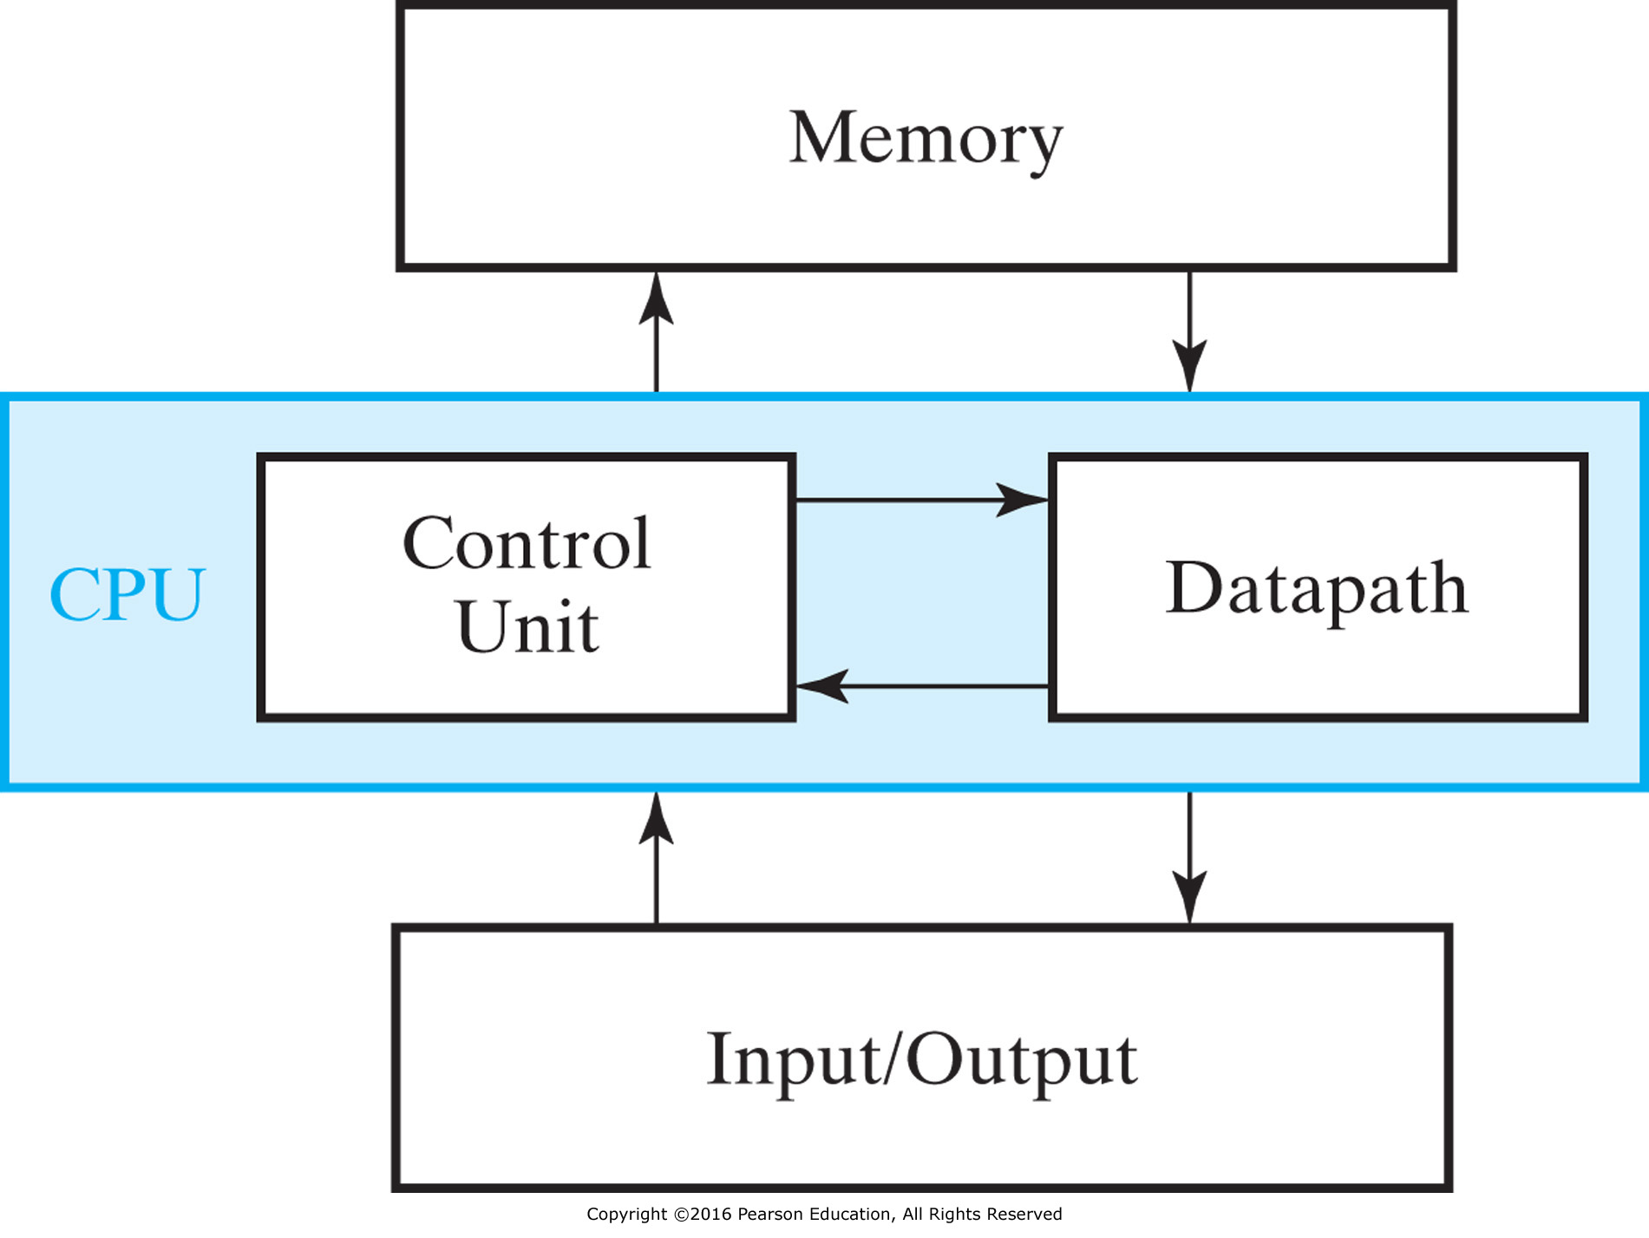
Figure 1-2 Block Diagram of a Digital Computer

Slide 4
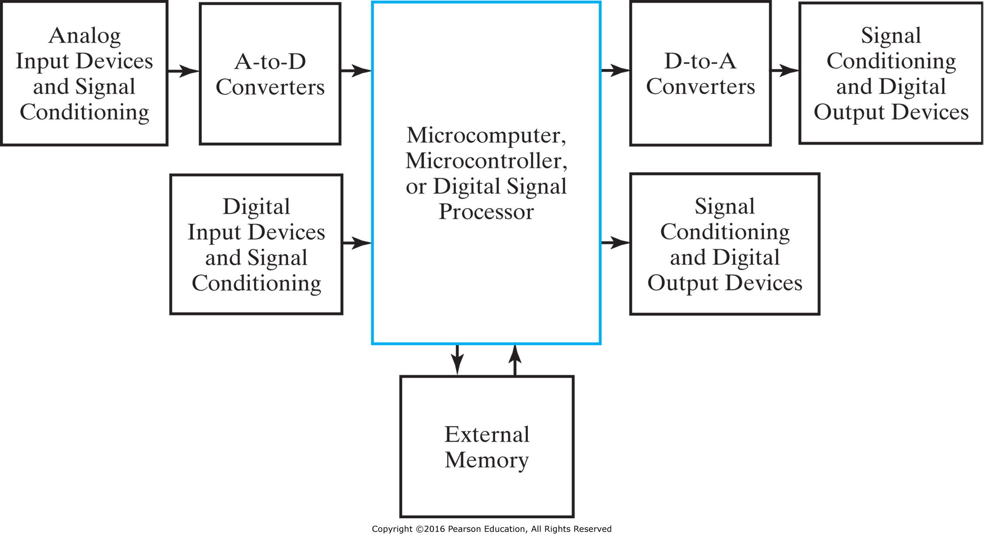
Figure 1-3 Block Diagram of an Embedded System

Slide 5
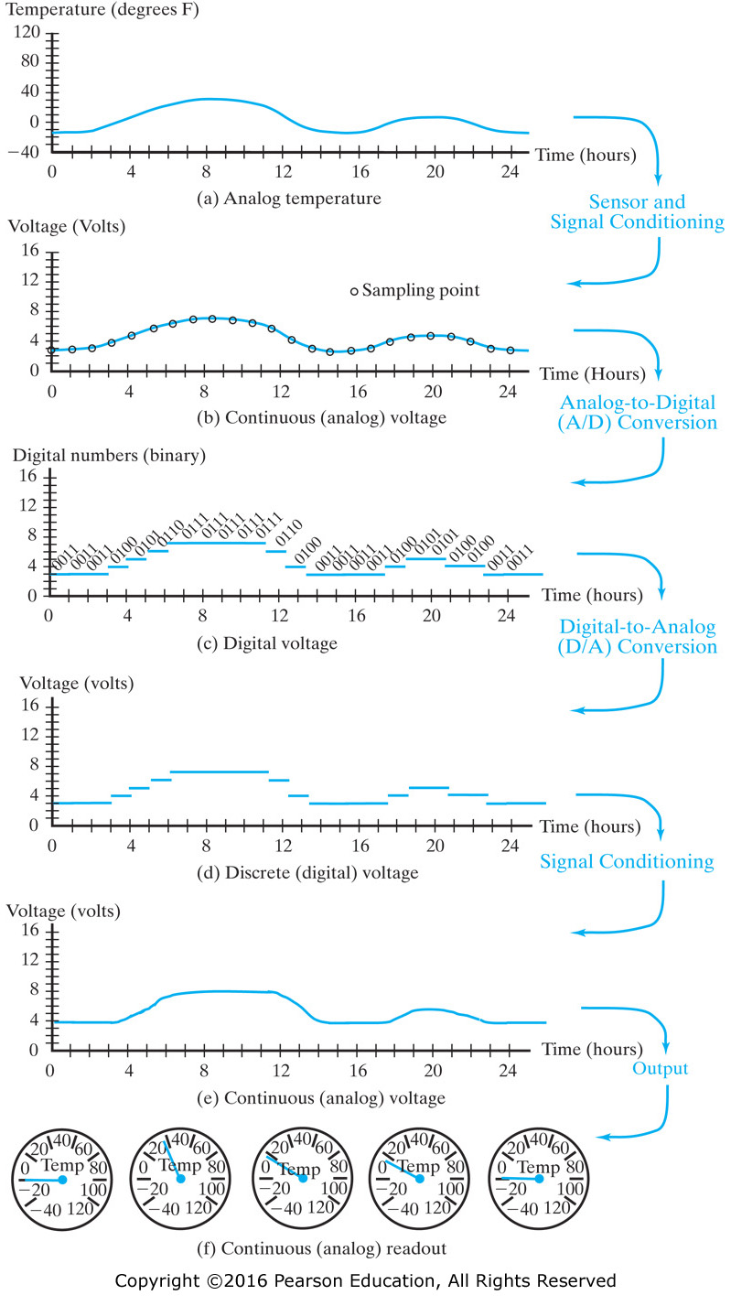
Figure 1-4 Temperature Measurement and Display

Slide 6
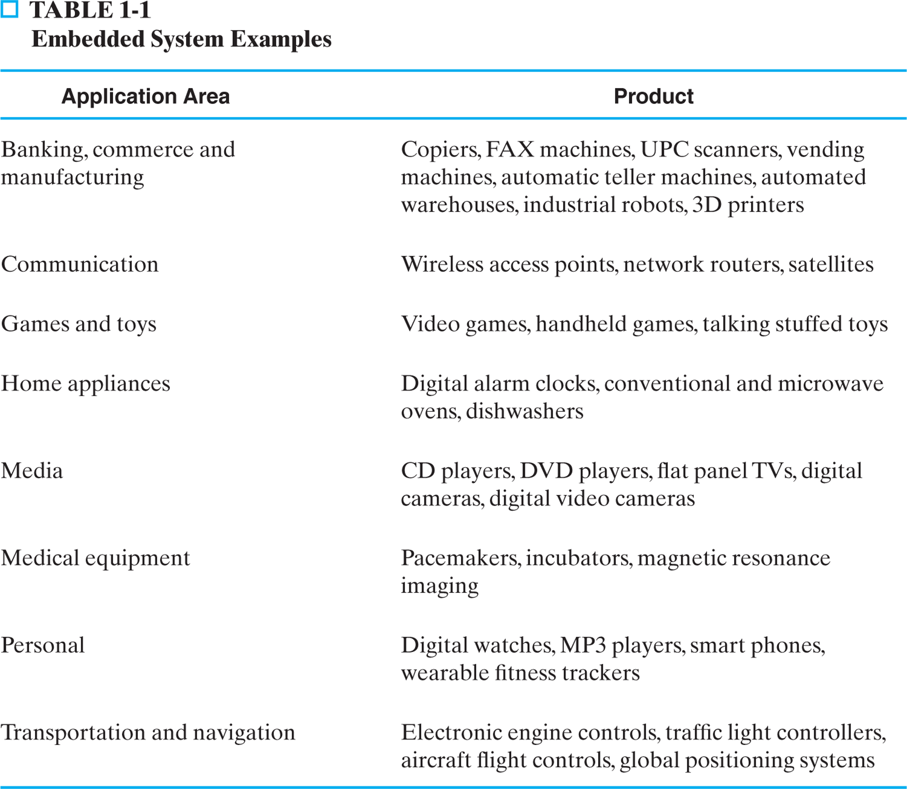
Table 1.1 Embedded System Examples

Slide 7
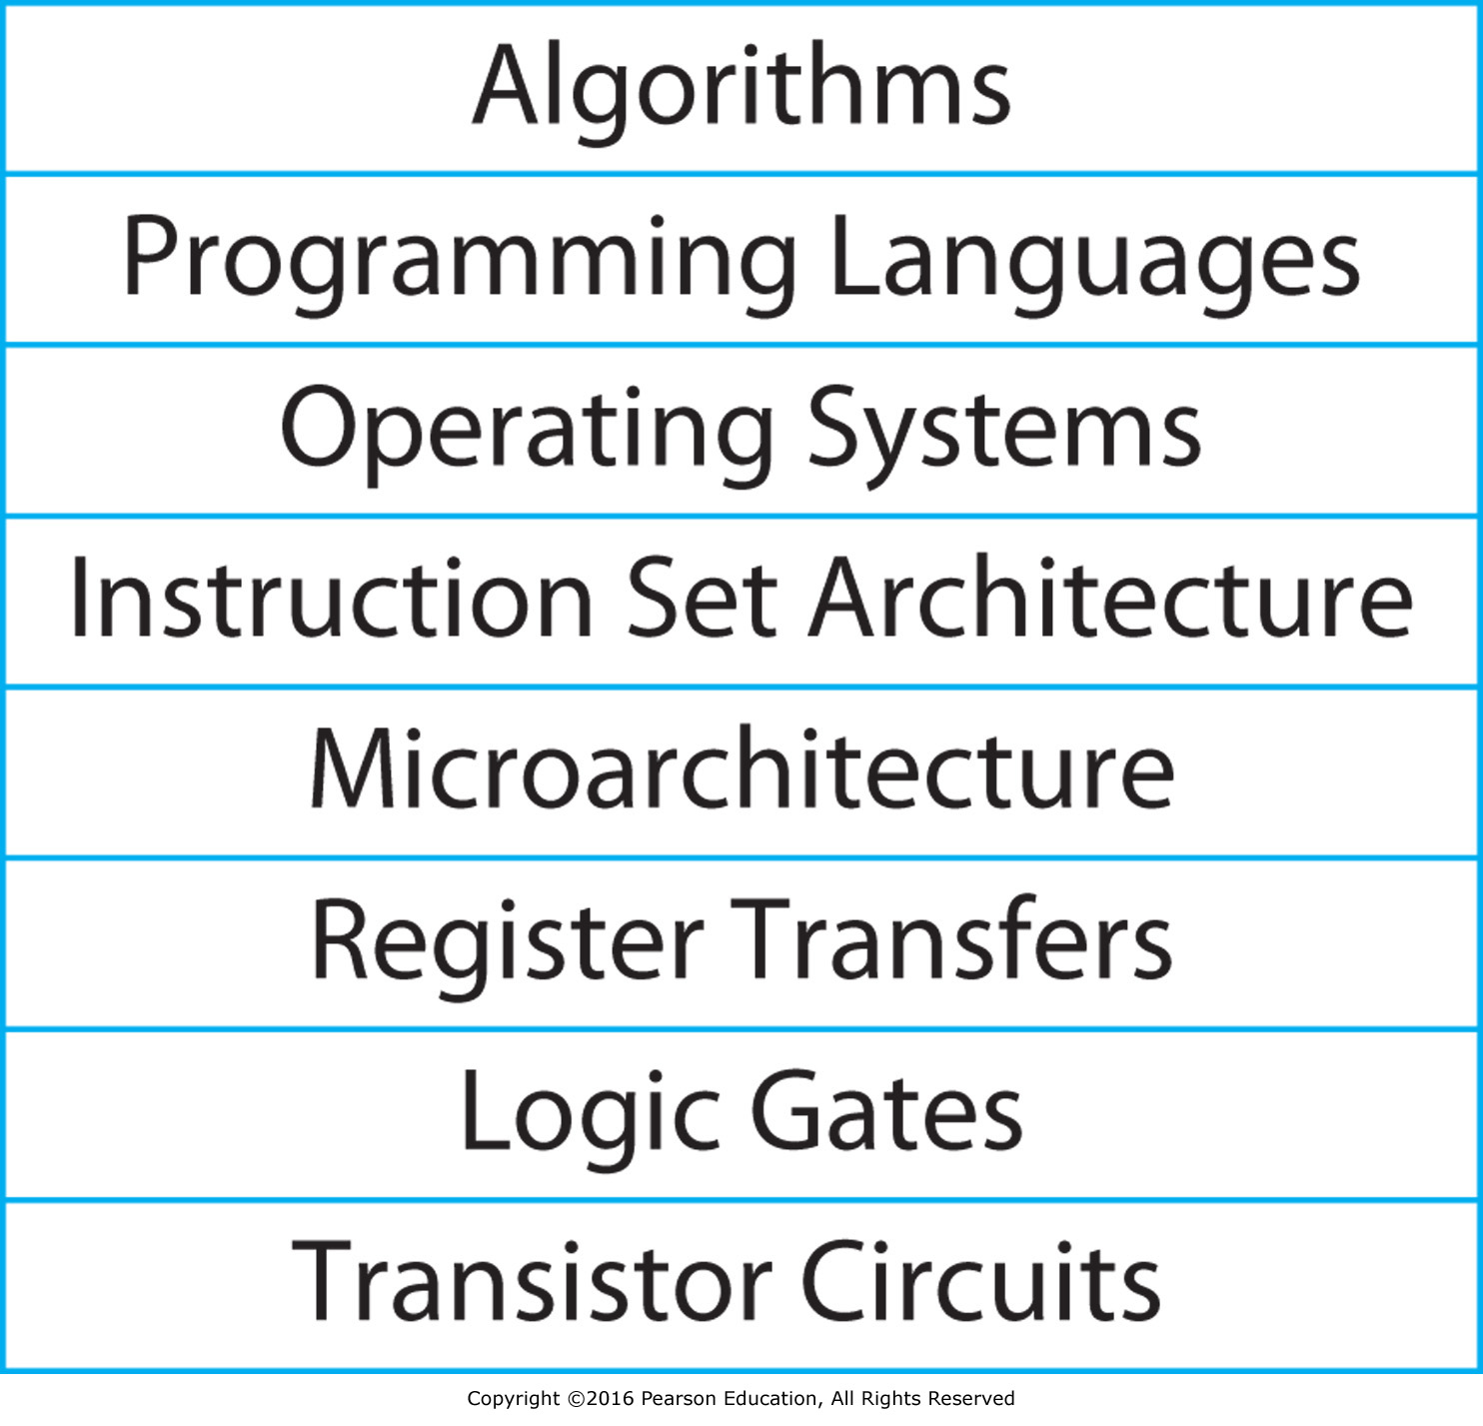
Figure 1-5 Typical Layers of Abstraction in Modern Computer Systems

Slide 8
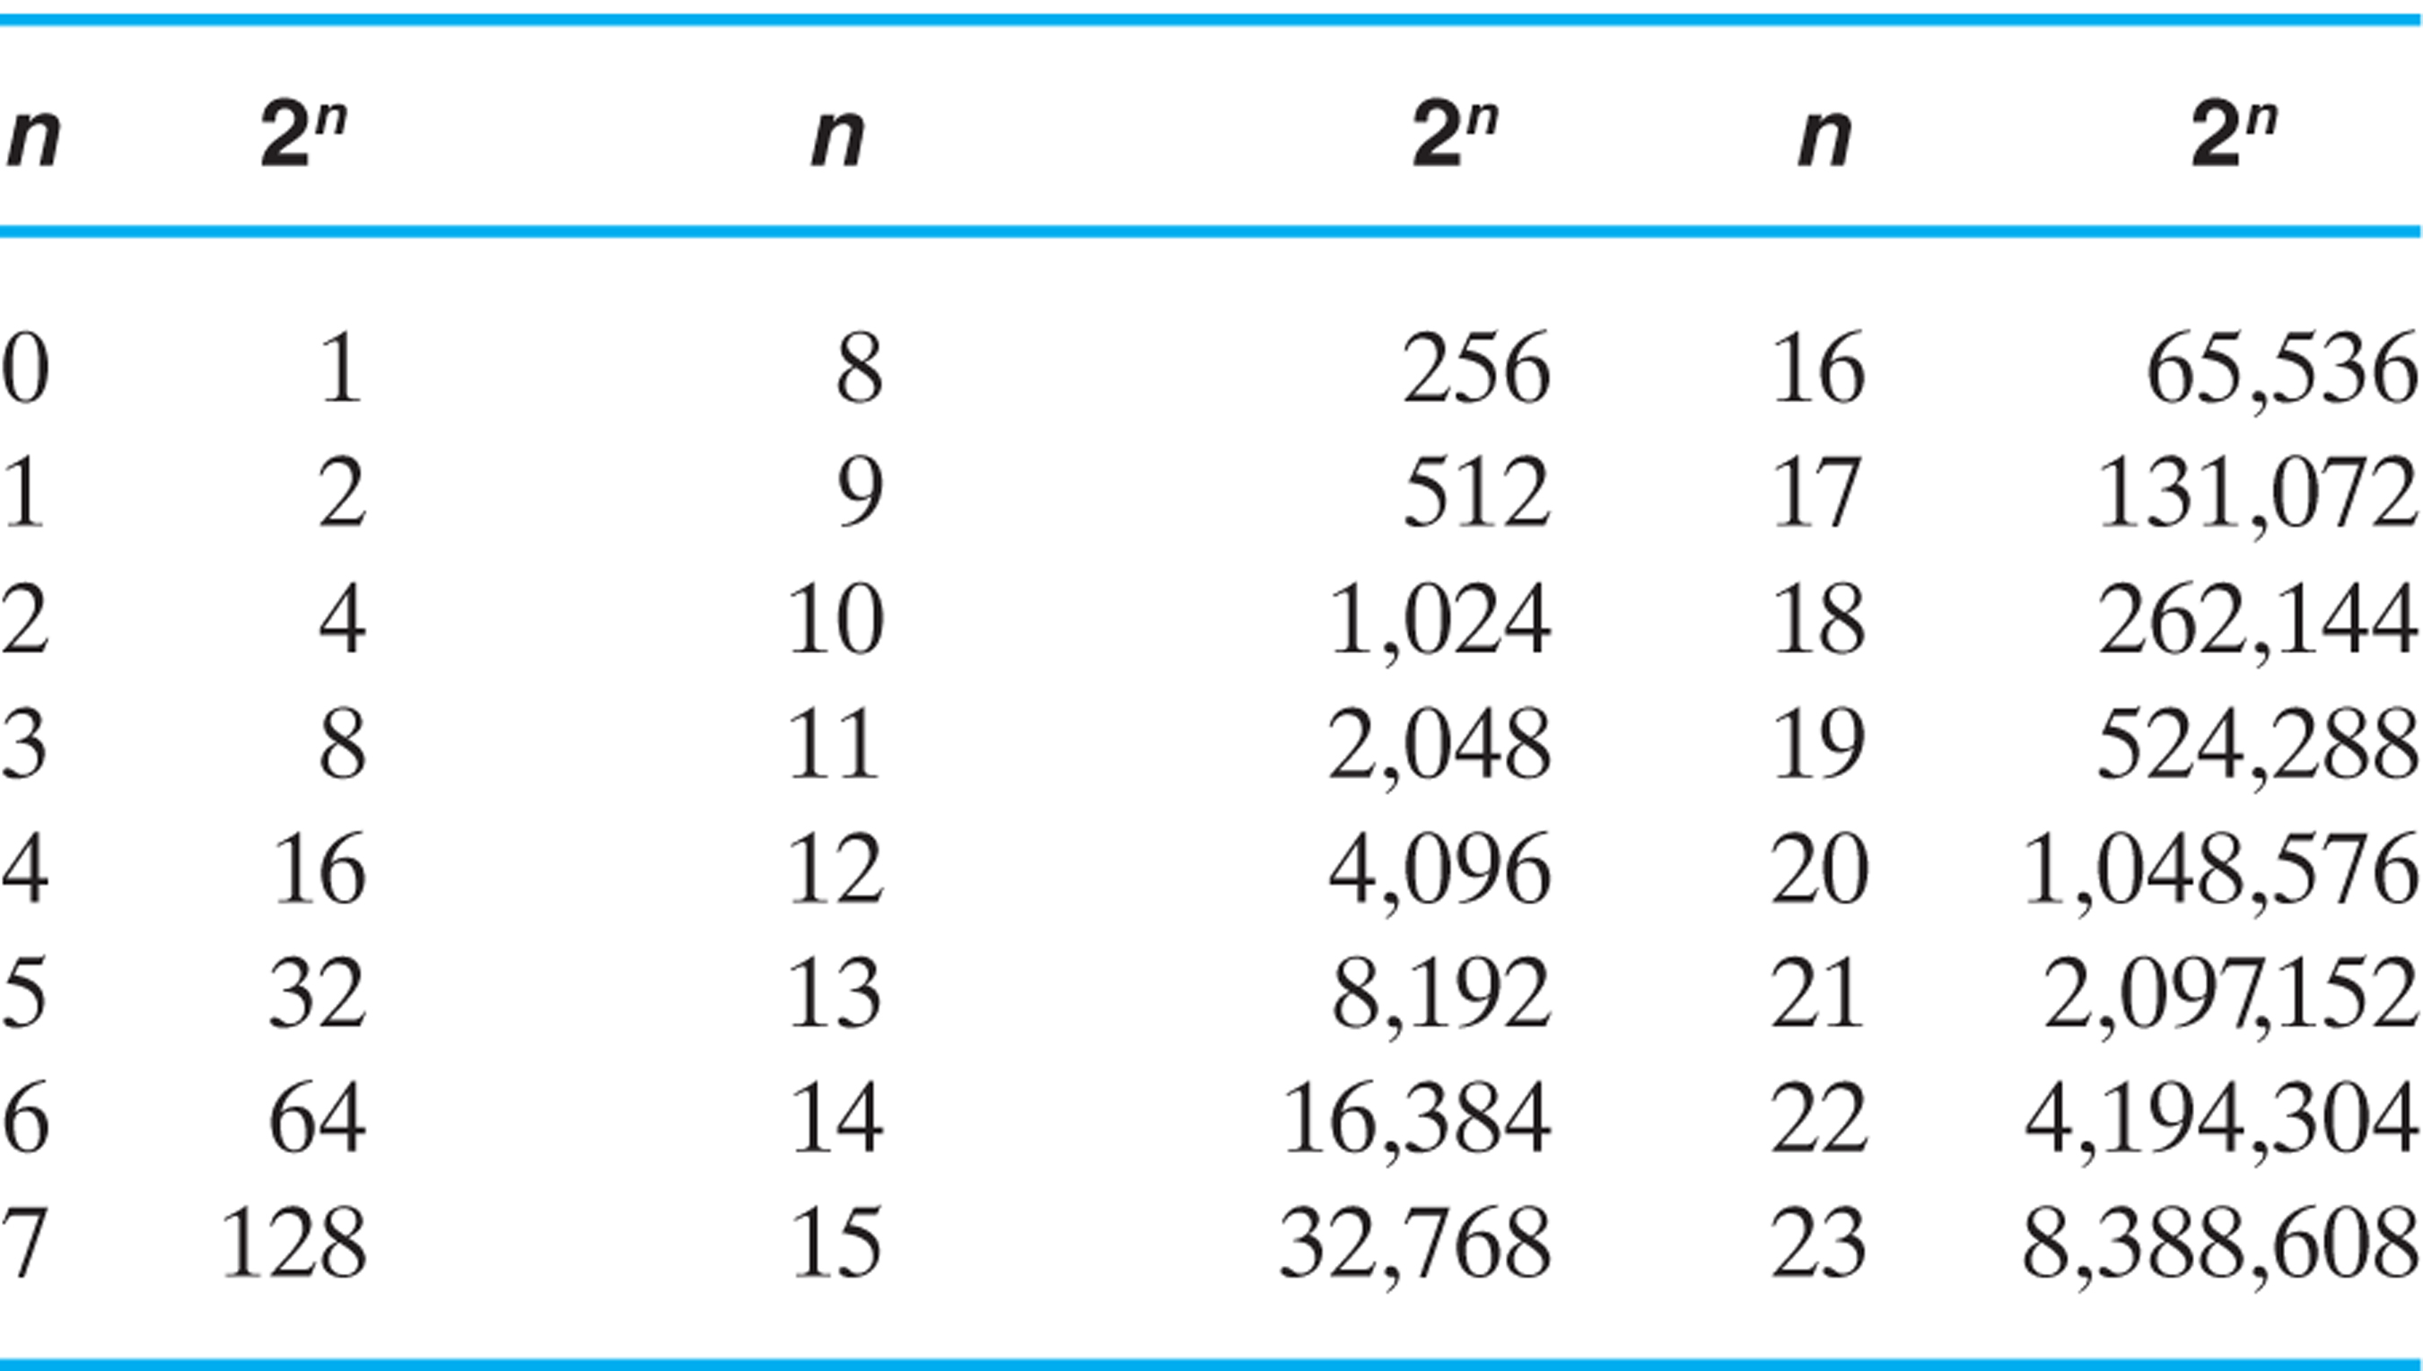
Table 1.2 Powers of Two

Slide 9
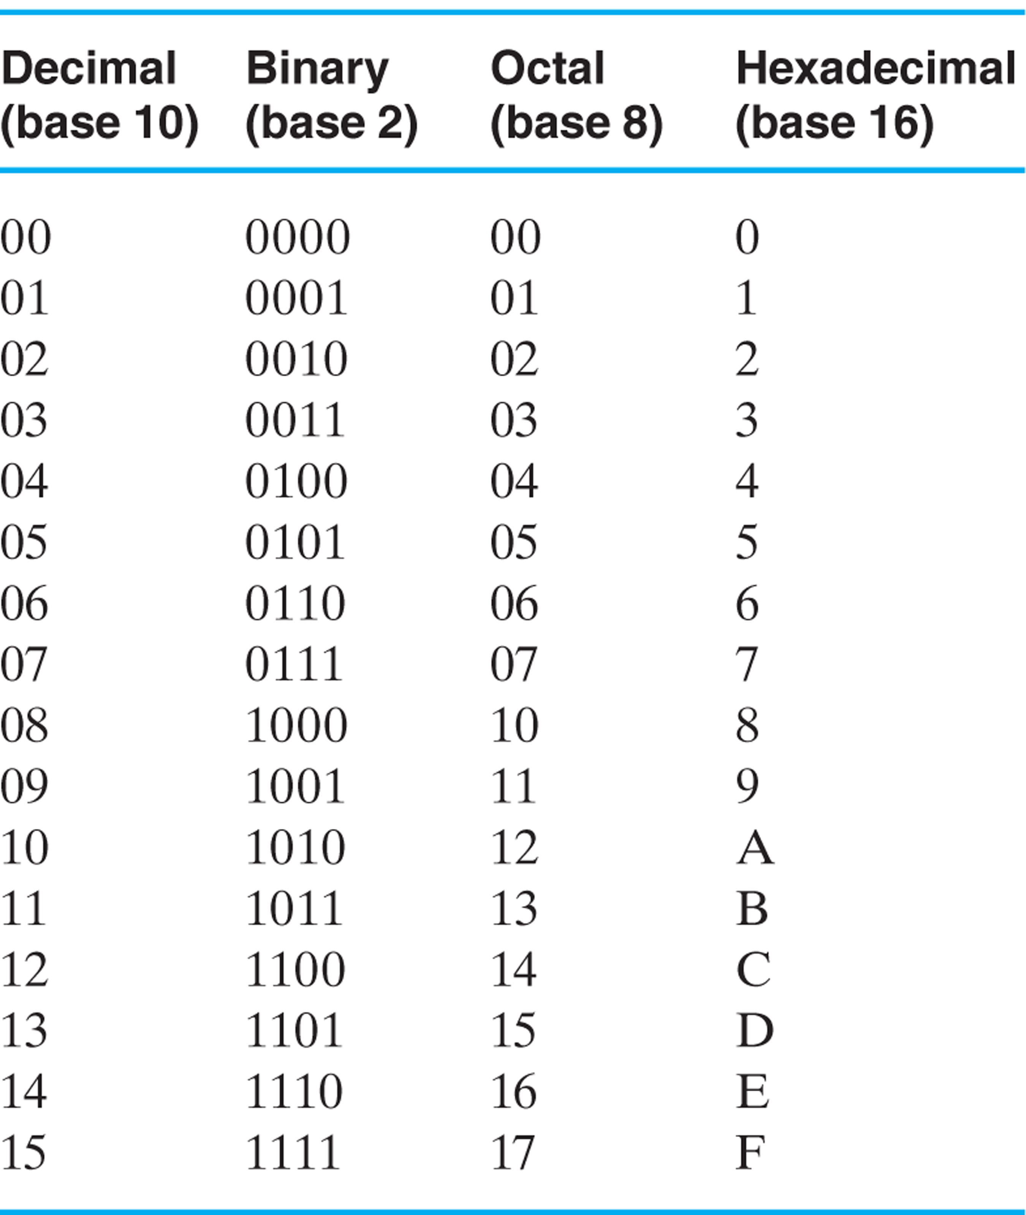
Table 1.3 Numbers with Different Bases

Slide 10
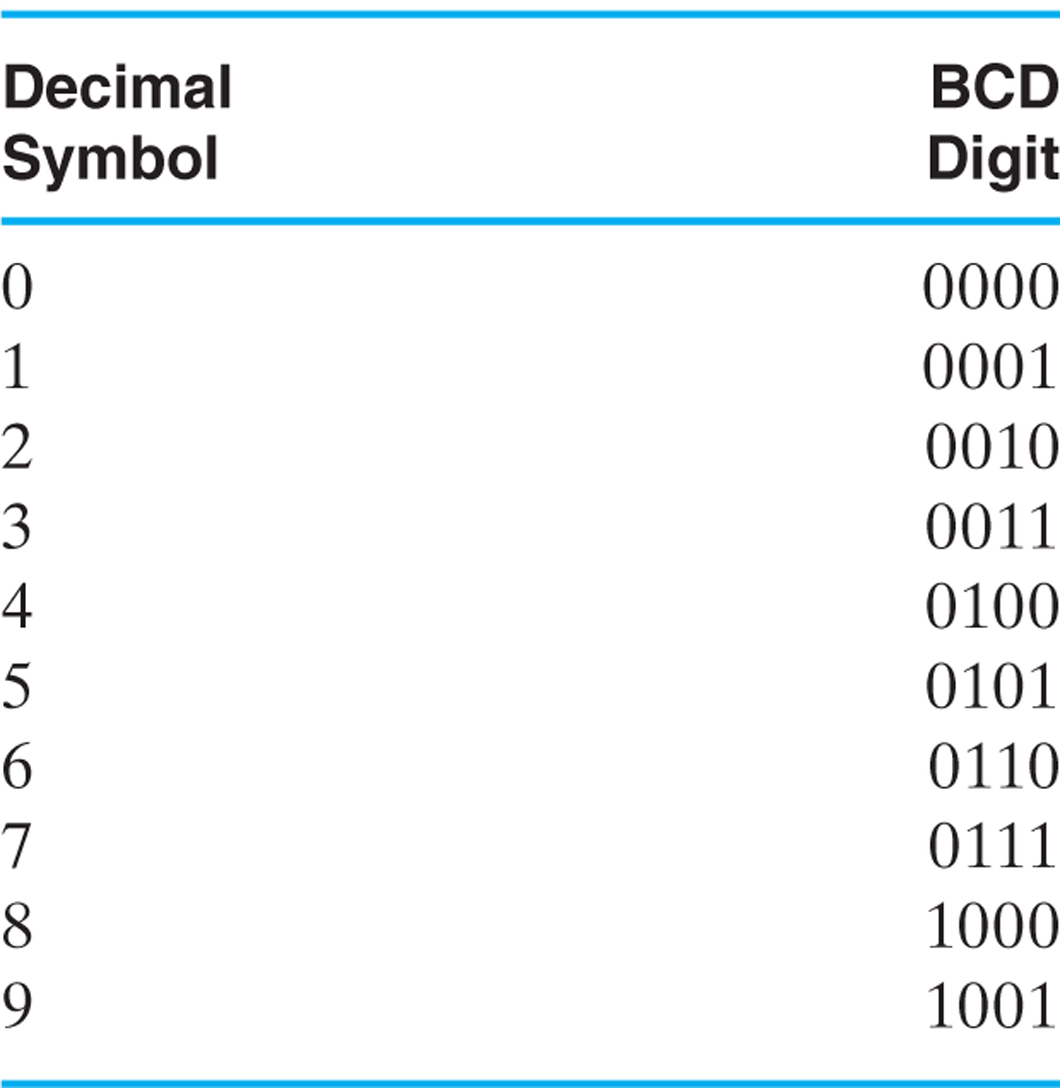
Table 1.4 Binary-Coded Decimal (B C D)

Slide 11
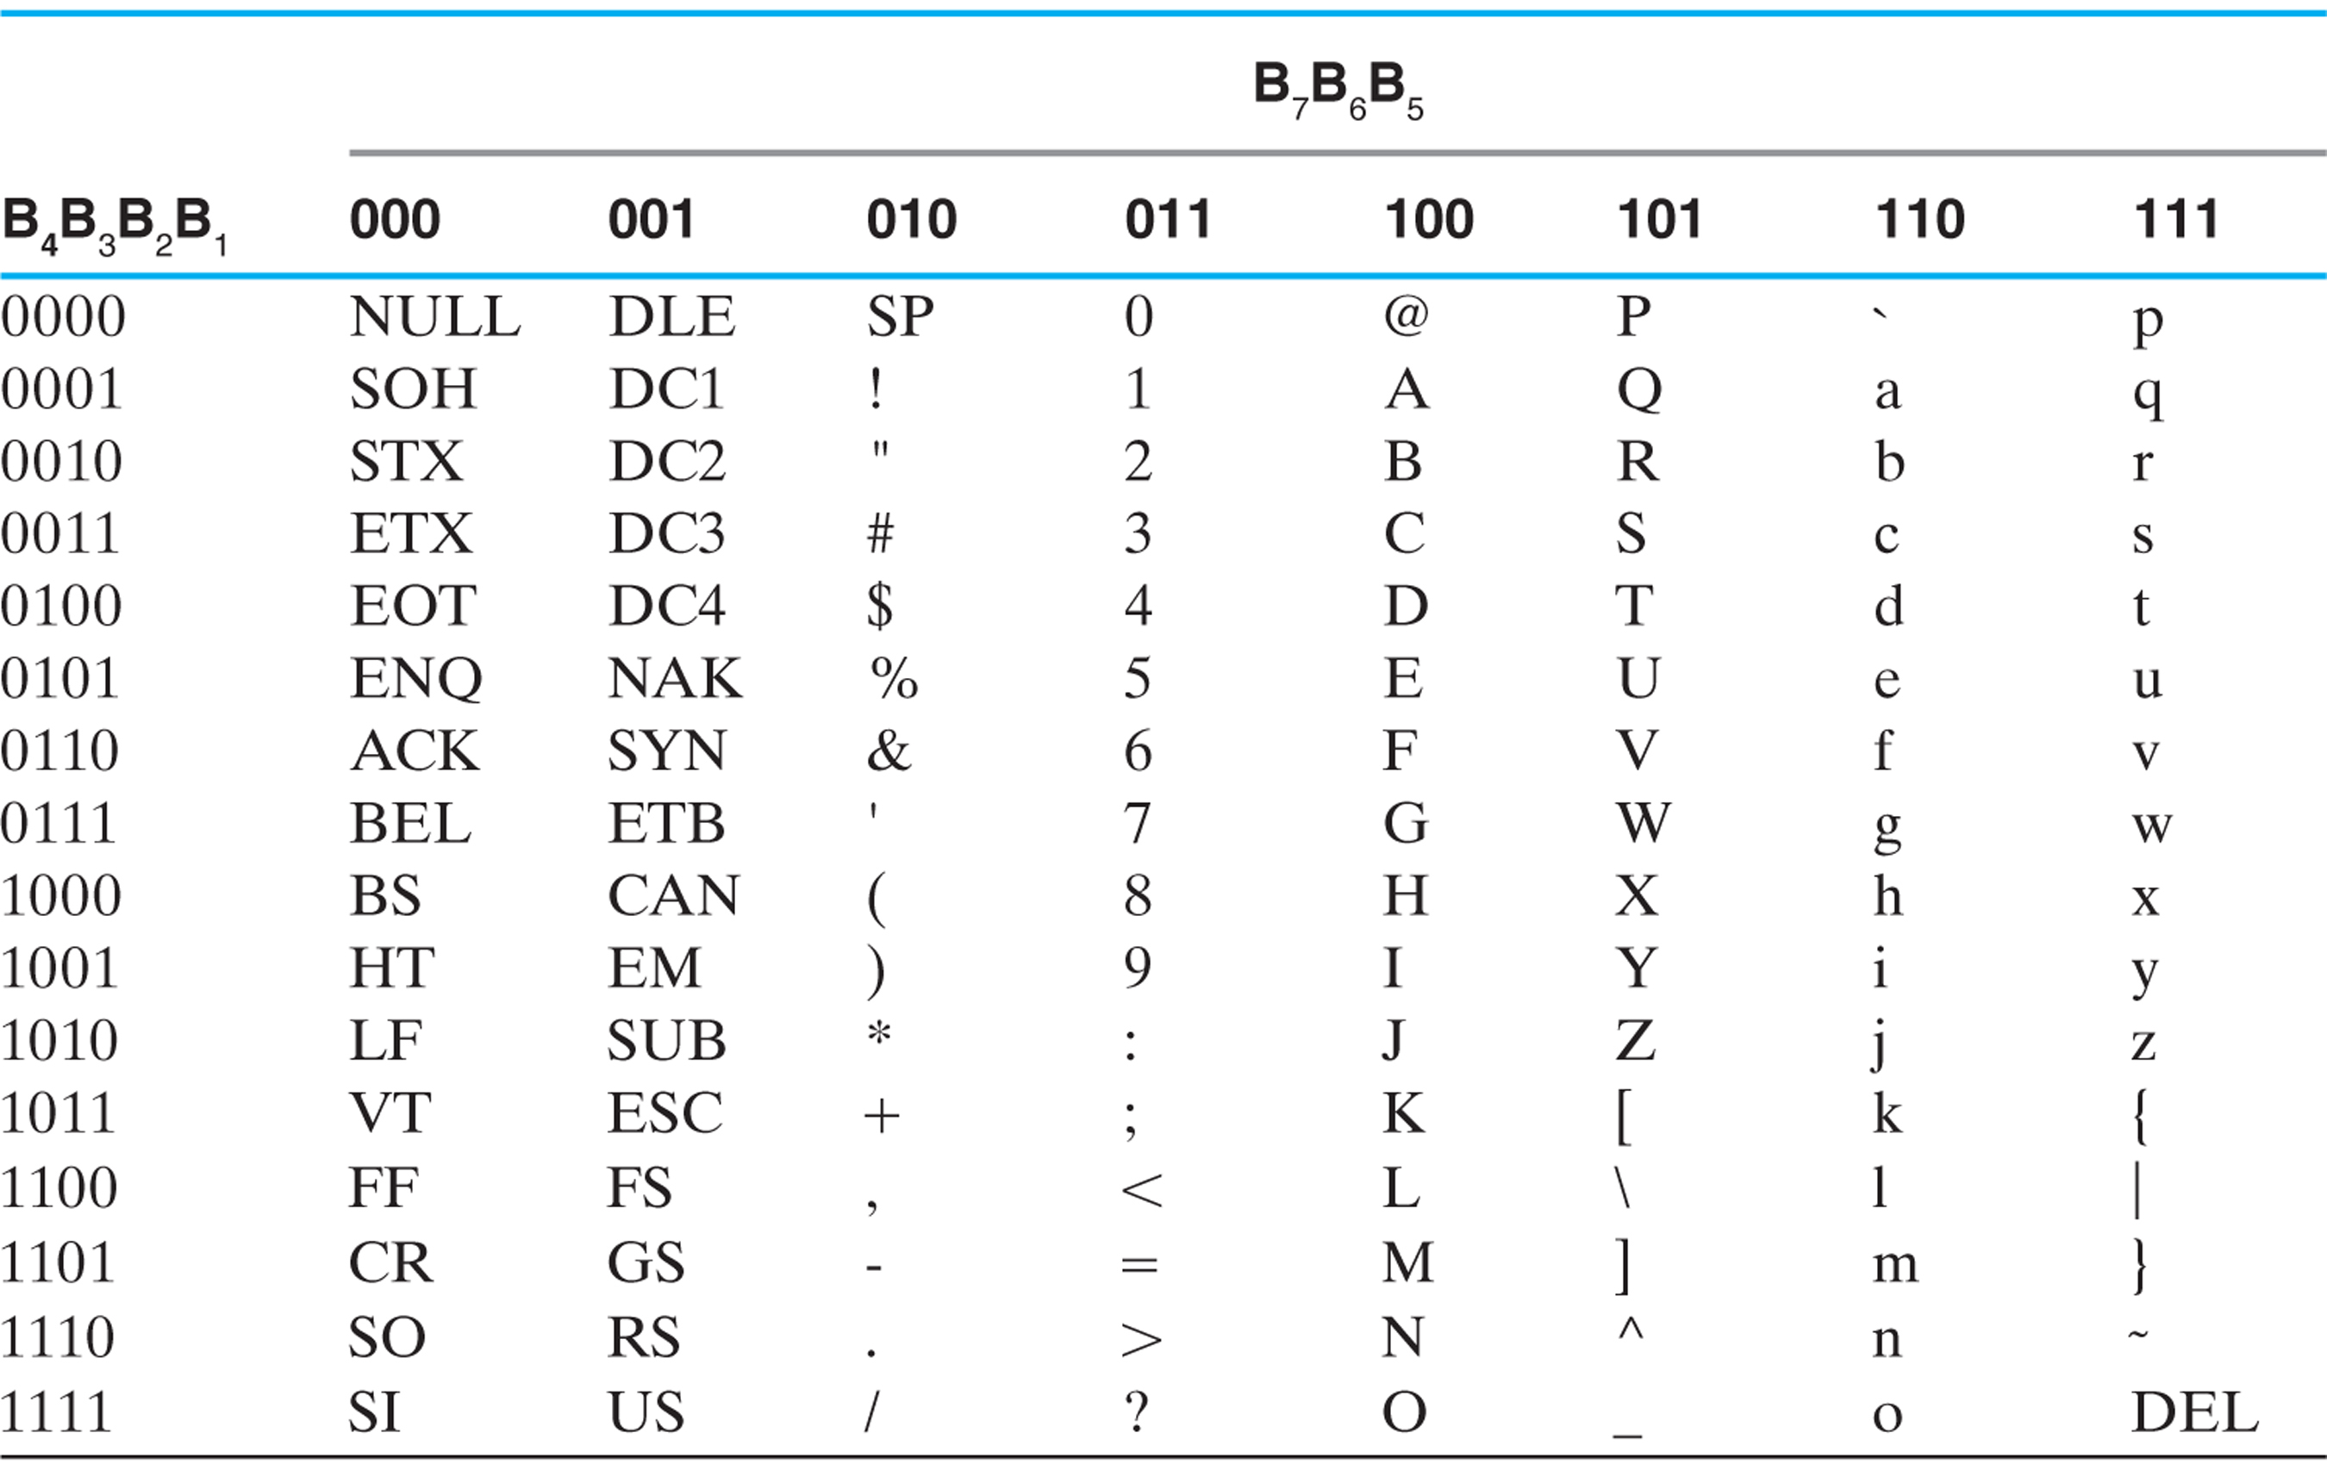
Table 1.5 American Standard Code for Information Interchange (A S C I I) (1 of 2)

Slide 12
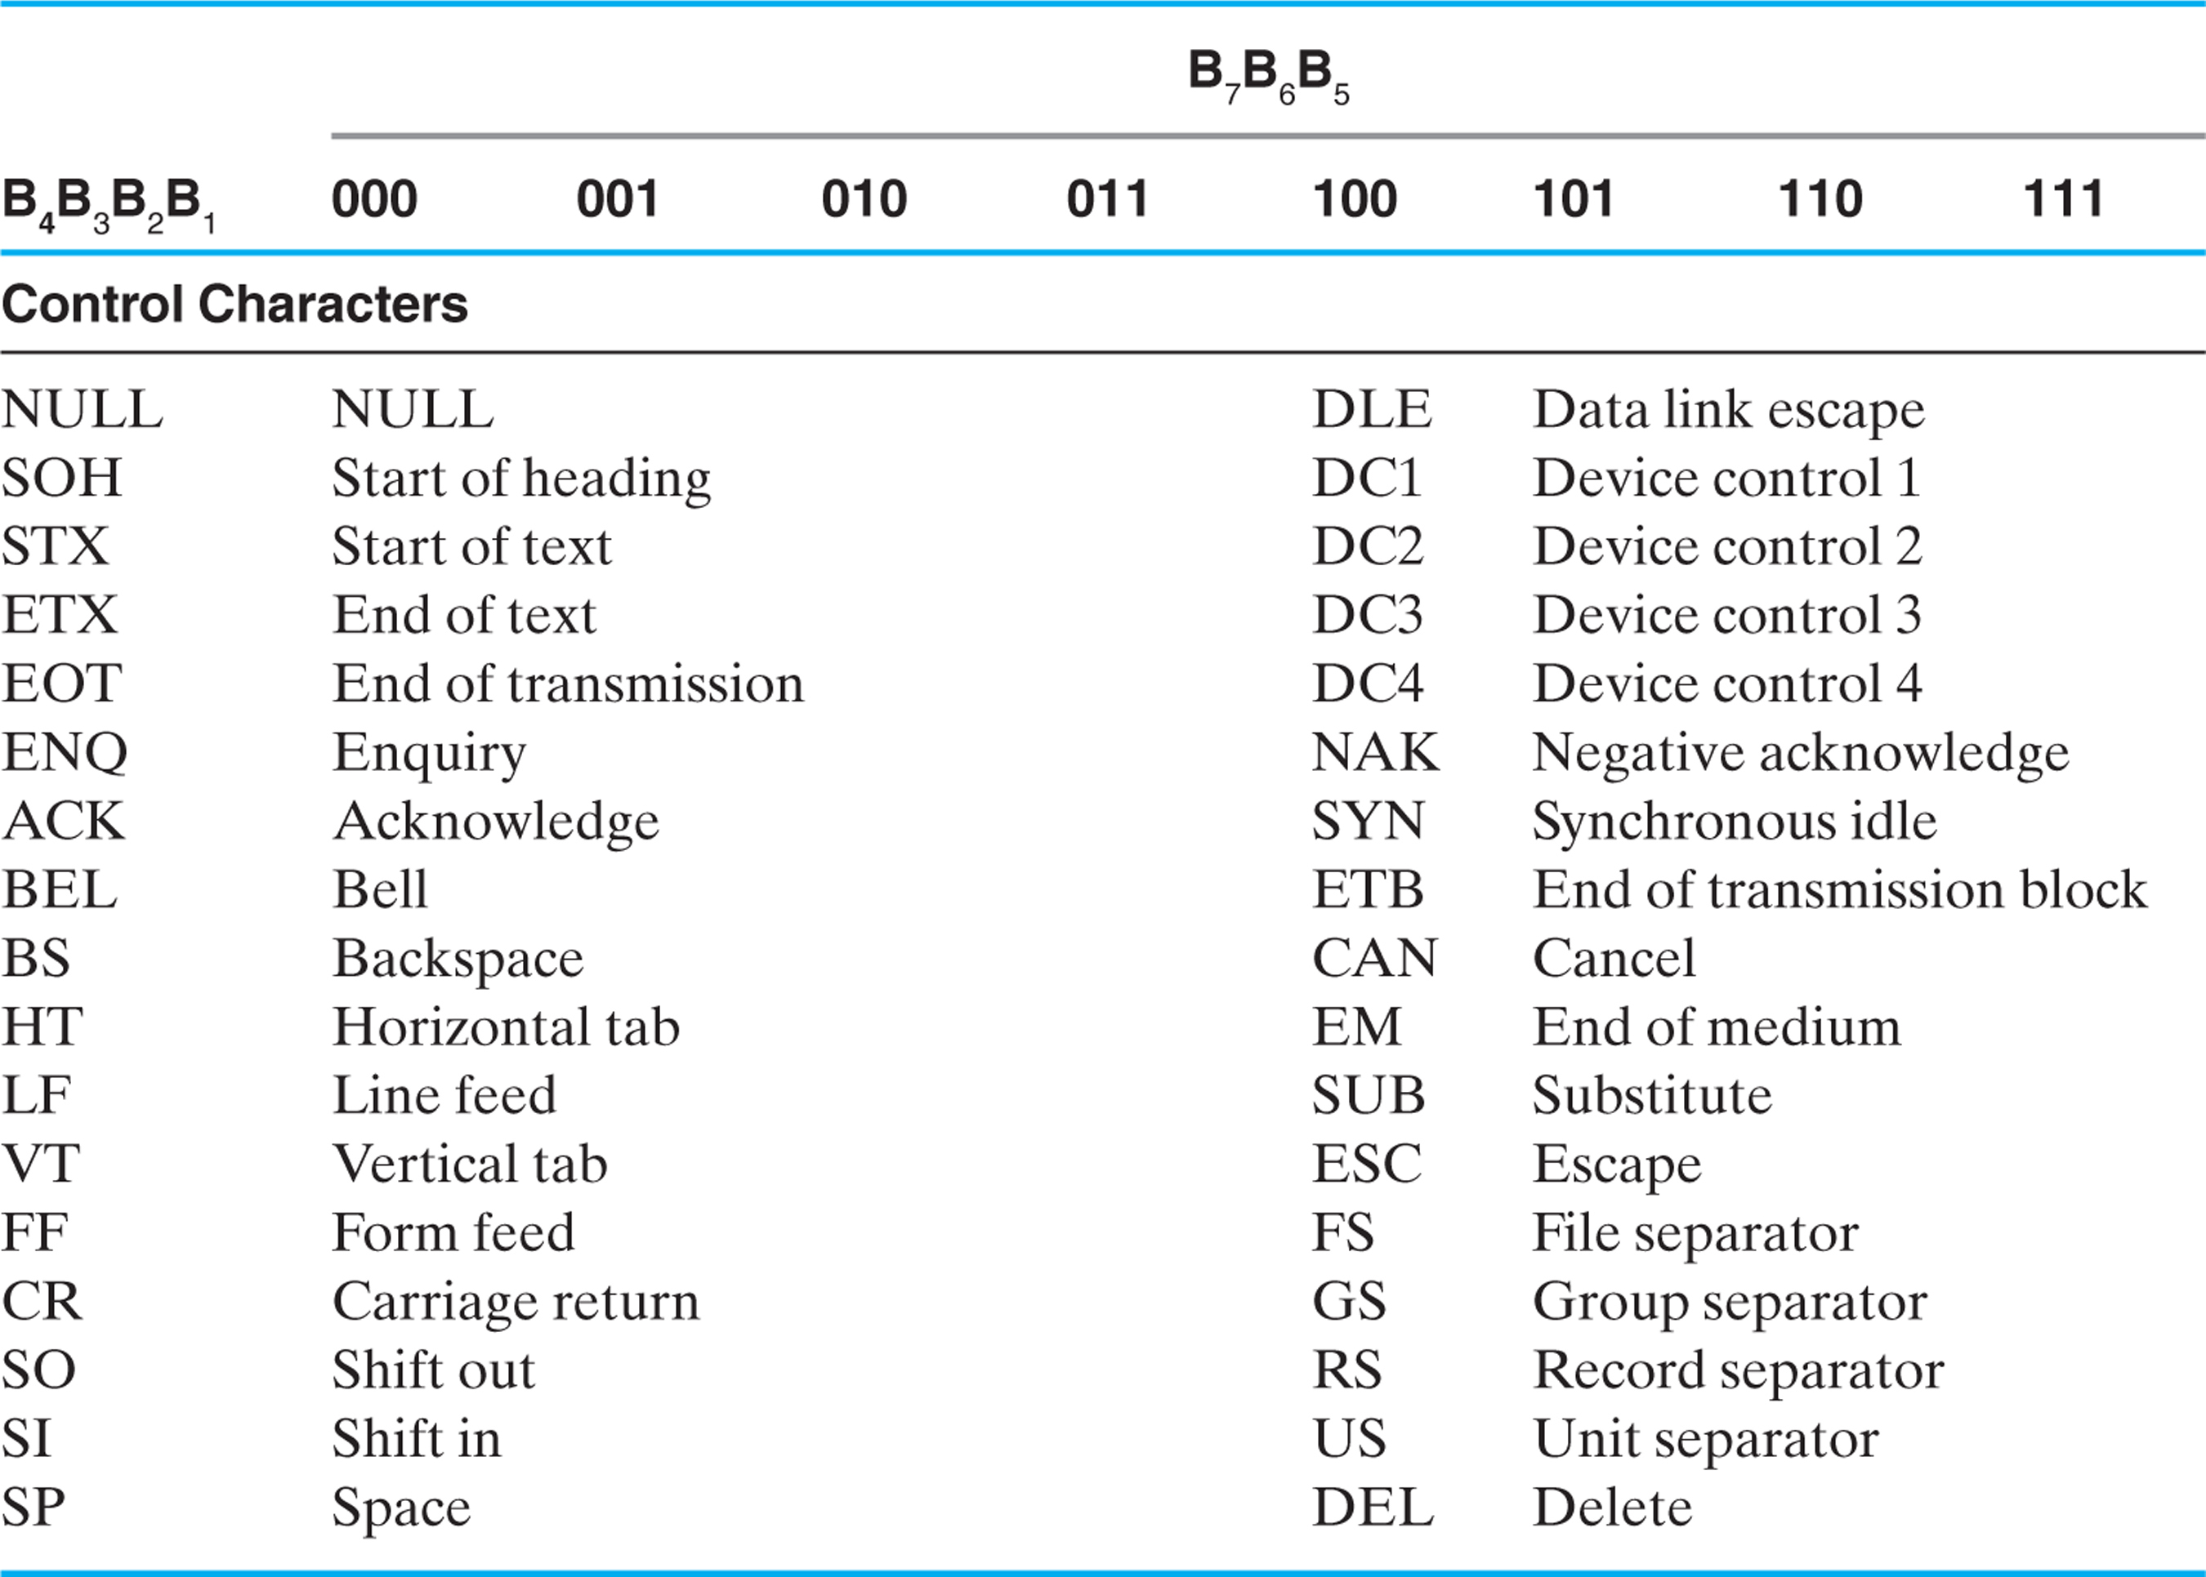
Table 1.5 American Standard Code for Information Interchange (A S C I I) (2 of 2)

Slide 13
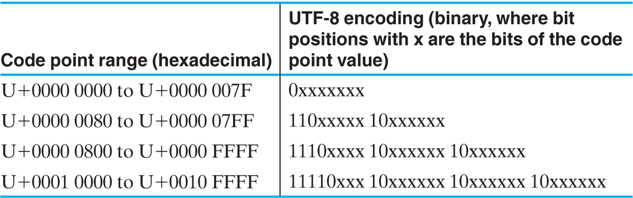
Table 1.6 U T F-8 Encoding for Unicode Code Points

Slide 14
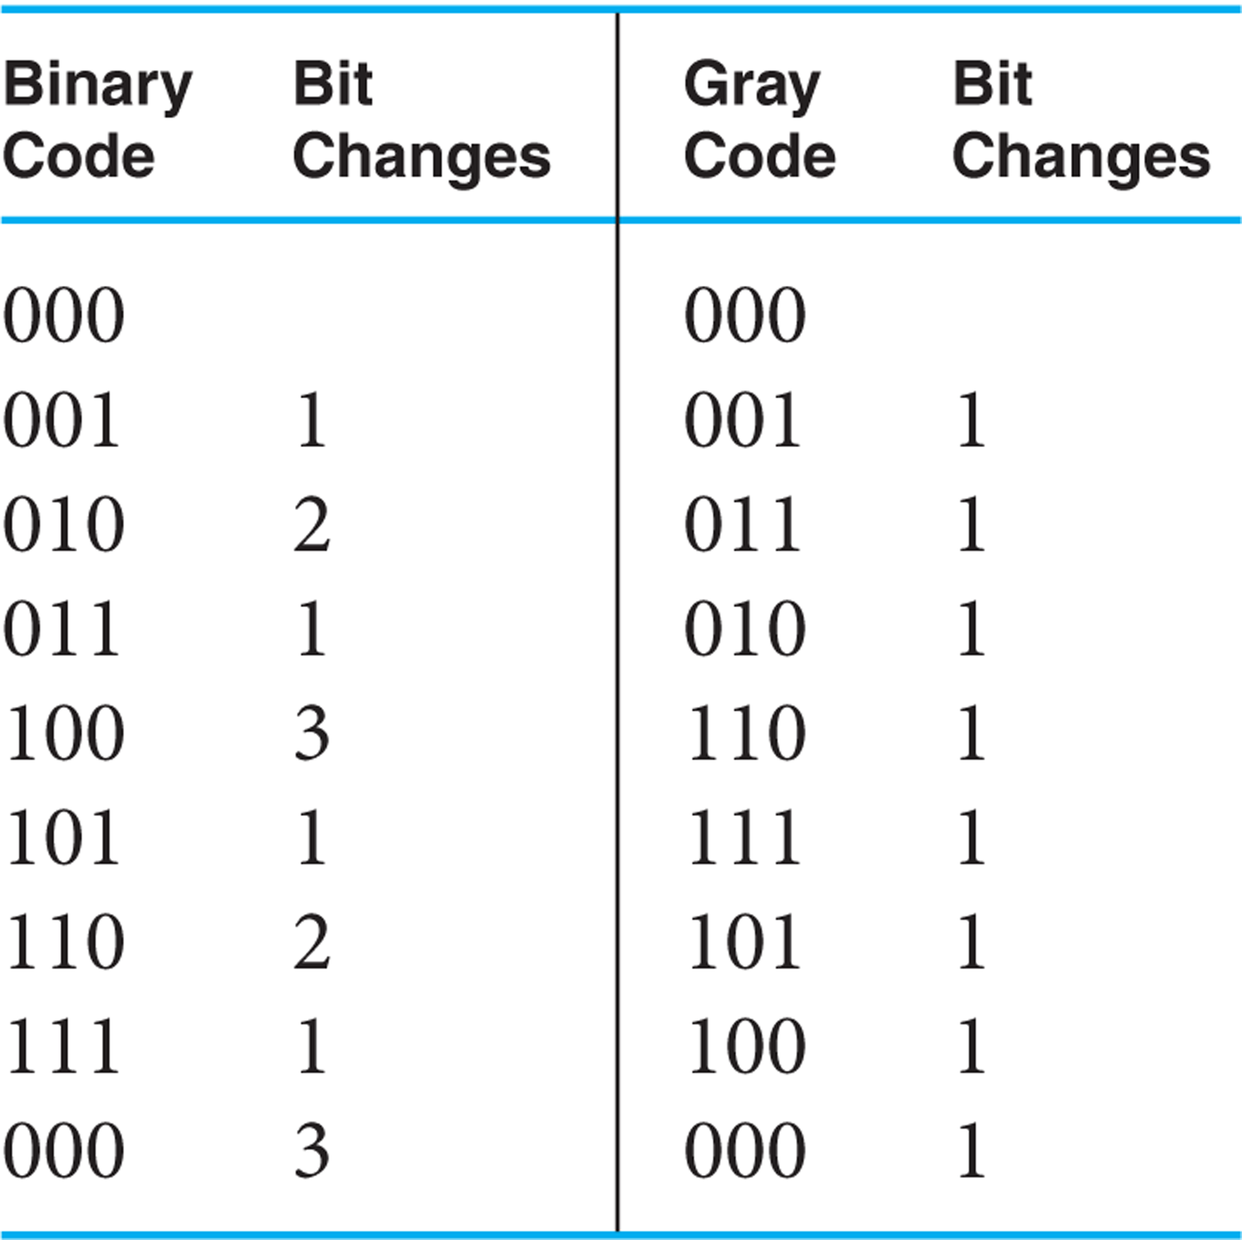
Table 1.7 Gray Code

Slide 15
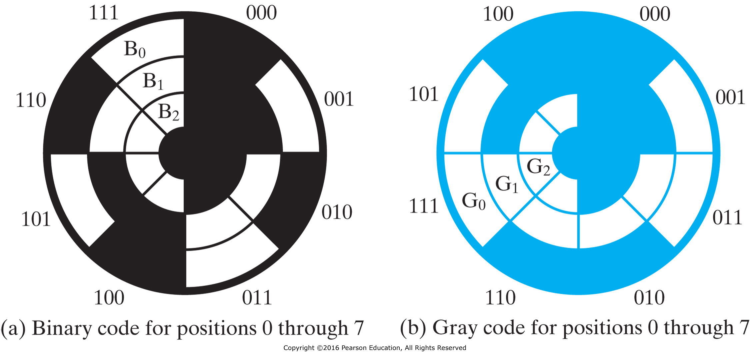
Figure 1-6 Optical Shaft-Angle Encoder

Slide 16

Copyright

